Slide 1
Symmetrical fault Analysis

Slide 2
Introduction on fault
A fault is any abnormal condition in a power system. The steady state operating mode of a power system is balanced 3-phase a.c. .However, due to sudden external or internal changes in the system, this condition is disrupted.
Fault in electrical equipment or apparatus is defined as an imperfection in the electrical circuit due to which current is deflected from the intended path. In other words, the fault is the abnormal condition of the electrical system which damages the electrical equipment and disturbs the normal flow of the electric current.
Under normal operating conditions, power system equipment or lines carry normal voltages and currents which results in a safer operation of the system. But when fault occurs, it causes excessively high currents to flow which causes the damage to equipment's and devices. Fault detection and analysis is necessary to select or design suitable switchgear equipment's, electromechanical relays, circuit breakers and other protection devices.
The faults in power system causes over current, under voltage, unbalance of the phases, reversed power and high voltage surges. This results in the interruption of the normal operation of the network, failure of equipments, electrical fires, etc.

Slide 3
CAUSES OF POWER SYSTEM FAULTS
The causes of faults are numerous, e.g.
Lightning
Switching overvoltage
Improper size of insulator and conductor
Heavy winds
Trees falling across lines
Vehicles colliding with towers or poles
Birds shorting lines
Insulation agening
Aircraft colliding with lines
Vandalism
Small animals entering switchgear
Line breaks due to excessive loading

Slide 4
Harmful Effect of Faults on Power System
On the occurrence of the fault, heavy short circuit current is flowing in the circuit. This current have the following disadvantages. Their consequences are explained below in details.
The heavy current due to fault causes excessive heating which may result in fire or explosion.
Sometimes the short circuit current takes the form of an arc that may cause considerable damage to the element of the power system.
The stability of the power system may be adversely affected, and even the complete shutdown of the power system may occur.
Damage to other apparatus in the system may be caused due to overheating and due to abnormal mechanical forces set up.
Usually power system networks are protected with switchgear protection equipment's such as circuit breakers and relays in order to limit the loss of service due to the electrical failures.

Slide 5
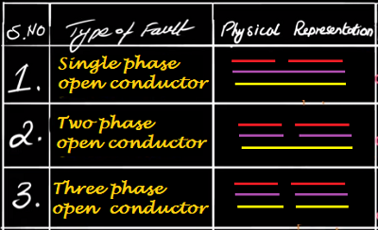
Types of Faults
The faults in the power system are mainly categorized into two types:
Open Circuit Fault
Short Circuit Fault
1. Open Circuit Fault
The open circuit fault happens due to the failure of one or two conductors. These faults take place in series with the line so referred as series fault. Such types of faults have a strong impact on the reliability of the system. The open circuit fault is classified as:
Open Conductor Fault
Two conductors Open Fault
Three conductors Open Fault
The most common causes of these faults include joint failures of cables and overhead lines, and failure of one or more phase of circuit breaker and also due to melting of a fuse or conductor in one or more phases.
Open circuit faults are also called as series faults. These are unsymmetrical or unbalanced type of faults except three phase open fault.

Slide 6
2. Short Circuit Faults
A short circuit can be defined as an abnormal connection of very low impedance between two points of different potential, whether made intentionally or accidentally.
These are the most common and severe kind of faults, resulting in the flow of abnormal high currents through the equipment or transmission lines. If these faults are allowed to persist even for a short period, it leads to the extensive damage to the equipment.
Short circuit faults are also called as shunt faults. These faults are caused due to the insulation failure between phase conductors or between earth and phase conductors or both.
The short-circuit fault is commonly divided into
i) Symmetrical fault
a) L-L-L fault
b) L-L-L-G fault
ii) Asymmetrical fault
a) line to ground (L-G) fault,
b) Phase to phase (line to line) (L-L) fault and
c) Double line to ground (L-L-G) fault.

Slide 7
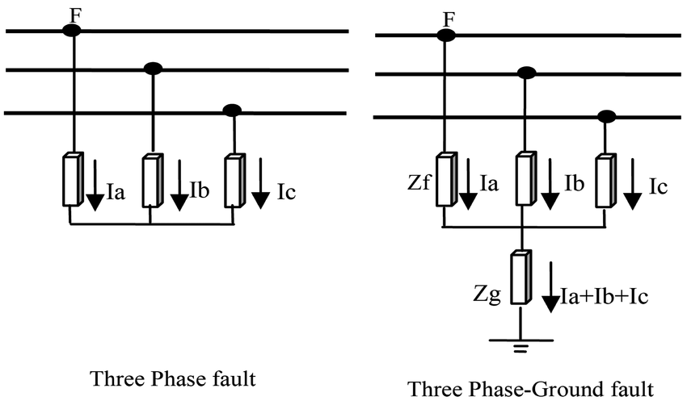
i) Symmetrical fault:
In such types of faults, all the phases are short-circuited to each other and often to earth. Such fault is balanced in the sense that the systems remain symmetrical, or we can say the lines displaced by an equal angle (i.e. 120° in three phase line). It is the most severe type of fault involving largest current, but it occurs rarely. For this reason balanced short- circuit calculation is performed to determine these large currents.
A rough occurrence of symmetrical faults is in the range of 2 to 5% of the total system faults. However, if these faults occur, they cause a very severe damage to the equipments even though the system remains in balanced condition.

Slide 8
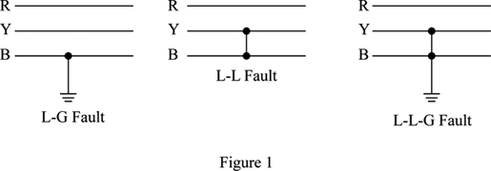
Unsymmetrical faults
Unsymmetrical faults involve only one or two phases. In unsymmetrical faults the three phase lines become unbalanced. Such types of faults occur between line-to-ground or between lines. An unsymmetrical series fault is between phases or between phase-to-ground, whereas unsymmetrical shunt fault is an unbalanced in the line impedances. Shunt fault in the three phase system can be classified as;
Single line-to-ground fault (LG).( occurance - Almost 60 to 75% of faults in a system )
Line-to-line fault (LL).(5 to 15% fault)
Double Line-to-ground fault (LLG). (About 15 to 25% faults)

Slide 9
NOTES:
Fault calculation involves finding the voltage and current distribution during the fault. When fault occurs, the corresponding MVA is called fault level at that point.
Symmetrical fault can be analyzed on per phase basic using Thevenin's theorem or bus impedance matrix.
THEVENIN’S EQUIVALENT CIRCUIT
Thevenin’s theorem states that any linear network containing any number of voltage sources and impedances can be replaced by a single emf and an impedance.
The emf is the open circuit voltage as seen from the terminals under consideration and the impedance is the network impedance as seen from these terminals.
This circuit consisting of a single emf and impedance is known as Thevenin’s equivalent circuit. The calculation of fault current can then be very easily done by applying this theorem after obtaining the open circuit emf and network impedance as seen from the fault point.

Slide 10
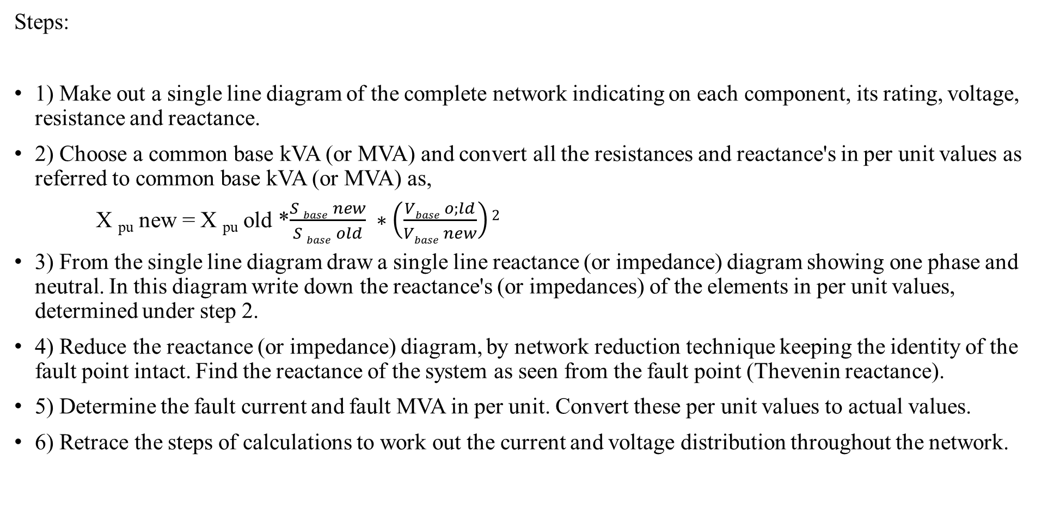
Analysis of symmetrical fault
Steps:
1) Make out a single line diagram of the complete network indicating on each component, its rating, voltage, resistance and reactance.
2) Choose a common base kVA (or MVA) and convert all the resistances and reactance's in per unit values as referred to common base kVA (or MVA) as,
X _{pu} new = X _{pu} old *$\frac{S base new}{S base old} ∗\left(\frac{Vbase o;ld}{Vbase new}\right)2$
3) From the single line diagram draw a single line reactance (or impedance) diagram showing one phase and neutral. In this diagram write down the reactance's (or impedances) of the elements in per unit values, determined under step 2.
4) Reduce the reactance (or impedance) diagram, by network reduction technique keeping the identity of the fault point intact. Find the reactance of the system as seen from the fault point (Thevenin reactance).
5) Determine the fault current and fault MVA in per unit. Convert these per unit values to actual values.
6) Retrace the steps of calculations to work out the current and voltage distribution throughout the network.

Slide 11
Current limiting reactor
A current limiting reactor, also sometimes called a series reactor, is an inductive coil having a large inductive reactance in comparison to its resistance and is used for limiting short circuit currents during fault conditions. These are installed in feeders and ties, in generator leads, and between bus sections to reduce the magnitude of short circuit currents and the effect of the resulting voltage disturbances.
The reactors allow free interchange of power under normal conditions but under short circuit conditions the disturbance is confined to the faulty section. As the resistance of reactors in comparison to their reactance is very small, the efficiency of the system is not affected appreciably.
Function of reactor
1. Protective reactors are used to reduce the flow of current into a short circuit so as to protect the apparatus from excessive mechanical stresses and from overheating and thus protect the system as a whole.
2. Protective reactors are used to reduce the magnitude of voltage disturbances caused by short circuits.
3. They also localize the fault by limiting the current that flows into the fault from other healthy feeders or parts of the system, thereby avoiding the fault from spreading. This increases the chances of continuity of supply.
4. They reduce the duty imposed on switching equipment during short circuits to be within economical ratings.
5. They are also used In systems where extensions have been made and the circuit-breaker rupturing capacities have become inadequate

Slide 12
Drawbacks of current limiting reactor
Current limiting reactors have some drawbacks too as with the introduction of the reactors, total percentage reactance of the circuit increases, thereby causing increase in reactive volt drop and decrease in power factor due to increased angle of lag. Thus regulation becomes poorer.
Working Principle of Current Limiting Reactors
Assume that the reactance of a circuit during fault is X and given voltage value is E. The short current value can be easily calculated using the below formula:
I_{sc} = E/X
This means the reactance of a circuit is inversely proportional to the short circuit current flowing in the circuit. Thus, when reactance increases, short circuit current decreases and vice versa.
Short circuit currents depend on: i) Generation capacity ii) Fault point voltage iii) Reactance of the circuit
The rating of reactors is labeled in KVA and formula for reactance % is as follows:
%X= KV drop/ KV (phase voltage)
The circuit breakers should have enough breaking current capacity—more than the expected fault currents. If the fault currents are beyond the capacity of the circuit breaker, the fault currents may not be interrupted. In large interconnected systems the total rating of the generators is very high and, therefore, the fault currents are very high. There is a possibility that the circuit breakers of suitable breaking capacity may not be available. So it becomes necessary to limit the fault currents by some means so that available or existing circuit breakers can be used safely for handling them.

Slide 13
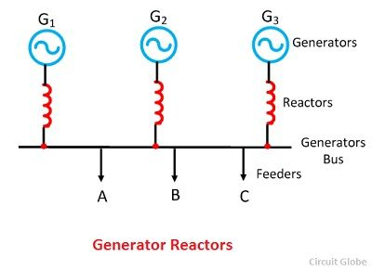
Location of Reactors
Reactors are located at different location in a power system for reducing the short circuit current. These reactors may be connected in series with the generators, feeders or in bus-bars as explained below.
i) Generators Reactors
Generator reactors are inserted between the generator and the generator bus. Such reactors protect the machines individually. In power station generator, reactors are installed along with the generators. The magnitude of reactors is approximately about 0.05 per unit. The main disadvantages of such type of reactors are that if the fault occurs on one feeder, then the whole of the system will be adversely affected by it.

Slide 14
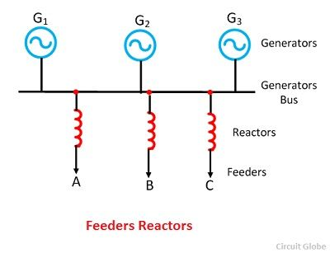
ii) Feeders Reactors
Reactors, which is connected in series with the feeder is called feeders reactor. When the fault occurs on any one feeder, then the voltage drops occur only in its reactors and the bus bar is not affected much. Hence the machines continue to supply the load. The other advantage is that the fault occurs on a feeder will not affect the others feeders, and thus the effects of fault are localized.
The disadvantage of such type of reactors is that it does not provide any protection to the generators against short circuit faults occurs across the bus bars. Also, there is a constant voltage drop and constant power loss in reactors during normal operating conditions.

Slide 15
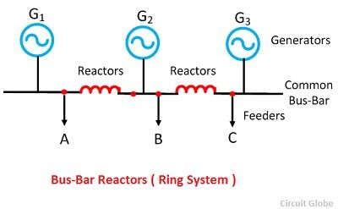
iii) Bus-Bar Reactor
When the reactors are inserted in the bus bar, then it is called bus-bar reactors. The constant voltage drop and constant power loss in reactors may be avoided by inserting the reactors in the bus bars. The bus bar reactor for ring system and the tie system are explained below.
Bus-Bar Reactors (Ring System)
Bus-bar reactors are used to tie together the separate bus sections. In this system sections are made of generators and feeders and these sections are connected to each other to a common bus bar. In such type of system normally one feeder is fed from one generator. In normal operating conditions a small amount of power flows through the reactors. Therefore voltage drop and the power loss in the reactor is low. The bus bar reactor, therefore, made with high ohmic resistance so that there is not much voltage drop across it.

Slide 16
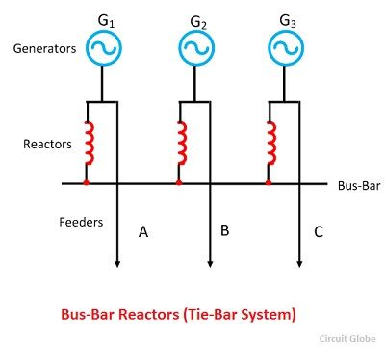
Bus-bar Reactors (Tie-Bus System)
This is the modification of the above system. In tie-bus system, the generator is connected to the common bus-bar through the reactors, and the feeder is fed from generator side.
The operation of the system is similar to the ring system, but it has got additional advantages. In this system, if the number of sections is increased, the fault current will not exceed a certain value, which is fixed by the size of the individual reactors.

Slide 17
Rated Interrupting current of the circuit breaker:
This is the maximum short circuit current or fault current that the breaker can with stand or interrupt with out any damage to the breaker. The rating is depend on the arc breaking capability of the arc contactors, arc chutes, It also depends on the circuit breaker cabinet ability to with stand the electromagnet stress associated with short circuit current. i.e. when large currents flows through the contacts then the attractive and repulsive forces will produce which introduces high stress on the insulating material and current carrying components.
The interrupting capacity of the circuit breaker is measured in MVA and it is calculated as follows
Interrupting capacity = √3 * Rated line voltage * Rated line current / 10⁶ (MVA)
For example a circuit breaker of 6600 V whose interrupting capacity of 500 MVA then the rated interrupting current
= (interrupting capacity / (√3 * rated voltage)) * 10⁶
= 500 * 10⁶ / √3 * 6600
= 43.7 K A
The rated peak current is equal to the rated short circuit current of the circuit breaker.

Slide 18
Breakers are identified by
nominal voltage class, such as 69 kV
rated continuous current
rated maximum voltage
voltage range factor, K
rated short circuit current at rated maximum voltage
The rated maximum voltage of a circuit breaker is the highest rms voltage for which the circuit breaker is designed.

Slide 19
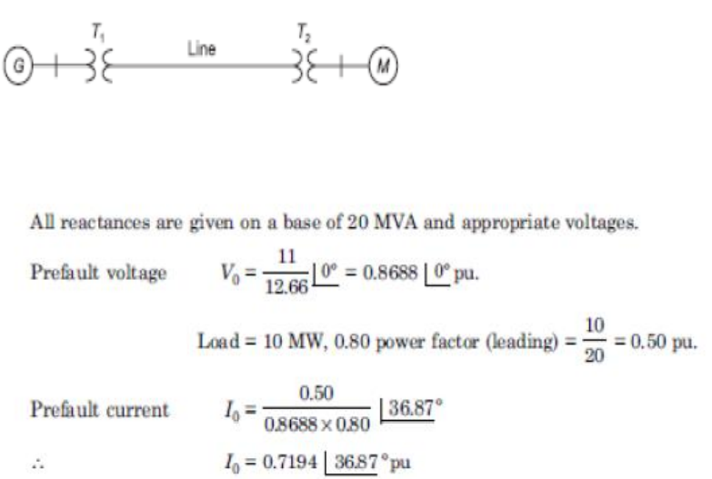
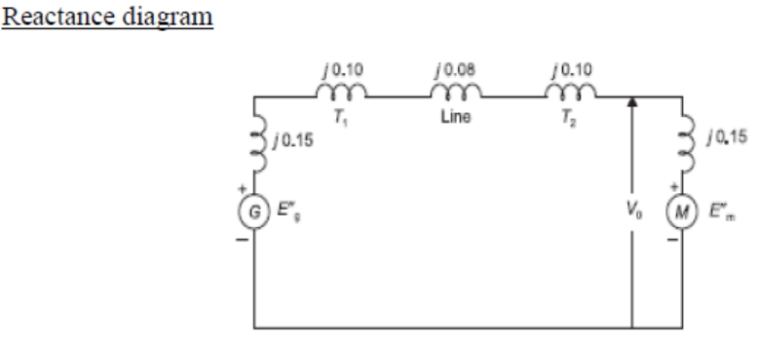
A synchronous generator and a synchronous motor each rated 20MVA, 12.66KV having 15% reactance are connected through transformers and a line as shown in fig. the transformers are rated 20MVA,12.66/66KV and 66/12.66KV with leakage reactance of 10% each. The line has a reactance of 8% on base of 20MVA, 66 KV. The motor is drawing 10MW at 0.8 leading power factors and a terminal voltage 11KV when symmetrical three phase fault occurs at the motors terminals. Determine the generator and motor currents. Also determine the fault current.

Slide 20
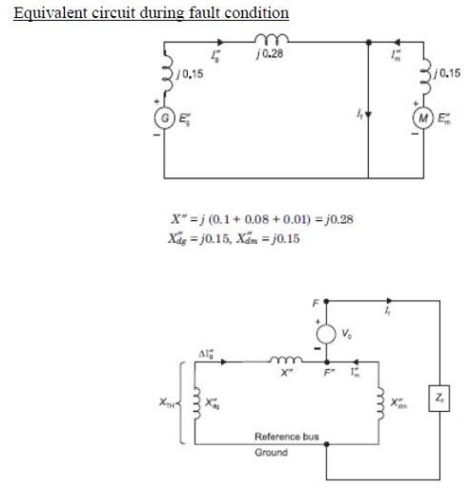

Slide 21
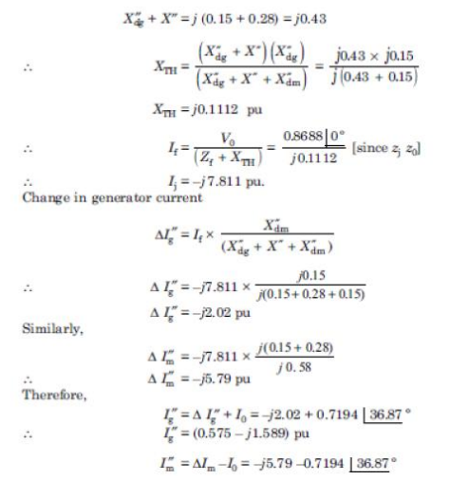

Slide 22
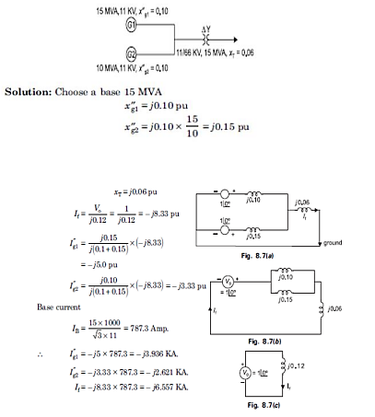
Two generators G1 and G2 are rated 15MVA, 11KV and 10MVA, 11KV respectively. The generators are connected to a transformer as shown in fig. Calculate the sub transient current in each generator when a three phase fault occurs on the high voltage side of the transformer

Slide 23
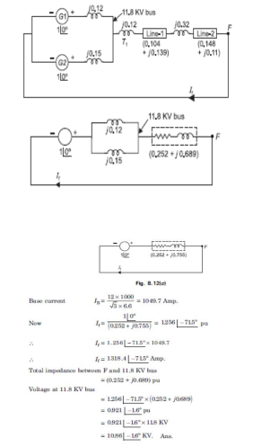
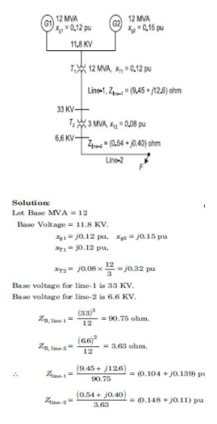
A radial power system network is shown in fig. a three phase balanced fault occurs at F. Determine the fault current and the line voltage at 11.8 KV bus under fault condition.

